Slide 1
Cortana Intelligence Suite
Cognitive Services
Notes:
Hi, I’m ___, and I’m excited to discuss Microsoft’s Cortana Intelligence Suite, and the value it can deliver to your organization.
More specifically, we’re going to talk about Microsoft Cognitive Services.

Slide 2
Business is being transformed by three trends
Big Data
Cloud
Intelligence
Notes:
But first, let me provide you a quick overview about how business is being transformed by three trends.
Today, the world around us is rapidly changing, faster than at any other point in history. This is an indicator of the fourth industrial revolution that is emerging, largely driven by the rise of Big Data, the growth of the cloud, and a new era of intelligence capabilities.
Thanks to the exponential proliferation of small, inexpensive chips and processors, computers are as ubiquitous as the people who use them – from traditional computers, tablets and phones to sensors and wearables. Machines are everywhere, constantly creating, collecting and making sense of the data in our midst. With the magic of machine learning and the limitless computing power of the cloud, this data is giving rise to intelligence that is augmenting human capabilities in exciting new ways.
Together, these technologies have the power to disrupt almost every industry, which is why this era is being heralded as the fourth industrial revolution. The breadth and depth of these changes is resulting in the transformation of entire systems of production, management, and governance.
At Microsoft, our ambition is to democratize the fourth industrial revolution by providing the building blocks to empower organizations large & small – enabling them to build, innovate and transform, and allowing them to get started quickly and see real business impact and results fast. We believe an organization’s data is a key strategic asset which, when combined with the cloud and the potential of intelligence capabilities, provides the opportunity to automate, innovate and increase the speed of business.
<Transition>: Our Cortana Intelligence Suite is designed to help you capitalize on these trends.

Slide 3



Stay ahead of the curve with Cortana Intelligence Suite
Business apps
People
Custom apps
Apps
Sensors and devices
Cortana Intelligence
Automated systems
Data
Intelligence
Action
Notes:
Cortana Intelligence is Microsoft’s fully managed intelligent, big data and advanced analytics offering in the cloud, designed to help you transform your data into intelligent action.
It is a comprehensive suite that brings together technologies throughout Microsoft. It provides fast and flexible deployment, with a simple monthly subscription to reduce time and cost challenges.
Cortana Intelligence enables customers to benefit from Microsoft’s investment in the intelligent cloud and advanced analytics, spanning our leading cloud platform with easy to use tools and services that integrate with existing infrastructure and enable enterprises to extend business solutions as their needs grow over time.
With Cortana Intelligence, we are taking years of research and innovation – spanning technology & infrastructure for advanced analytics, including capabilities such as machine learning, big data storage and processing in the cloud, intelligence capabilities like vision, face and speech recognition, and integration with Cortana, Microsoft’s personal digital assistant, with the goal of helping enterprise customers make better, faster decisions to accelerate their speed of business.
<Transition>: Let’s talk about how some of our customers are benefiting from Cortana Intelligence.

Slide 4



Easily turn data into intelligent action
Information Management
Big Data Stores
Machine Learning and Analytics
Intelligence
Data Sources
People
Data Factory
Data Lake Store
Machine Learning
Cognitive Services
Data Catalog
SQL Data
Warehouse
Data Lake Analytics
Bot Framework
Web
Apps
HDInsight
(Hadoop and Spark)
Event Hubs
Cortana
Mobile
Apps
Stream Analytics
Bots
Dashboards & Visualizations
Sensors and devices
Power BI
Automated Systems
Data
Intelligence
Action
Notes:
Cortana Intelligence delivers an end-to-end platform with an integrated and comprehensive set of tools and services to help you build intelligent applications that let you easily take advantage of Advanced Analytics and intelligence capabilities.
First, Cortana Intelligence provides services to bring data in, so that you can analyze it. It provides information management capabilities like Azure Data Factory so that you can pull data from any source (relational DB like SQL or non-relational ones like your Hadoop cluster) in an automated and scheduled way, while performing the necessary data transforms (like setting certain data columns as dates vs. currency etc). Think ETL (Extract, Transform, Load) in the cloud. Event Hubs does the same for IoT type ingestion of data that streams in from lots of end points.
The data brought in then can be persisted in flexible big data storage services like Data Lake Store and Azure SQL Data Warehouse.
You can then use a wide range of analytics services from Machine Learning to Azure Data Lake Analytics to Azure HDInsight to Azure Stream Analytics to analyze the data stored in the big data storage. This means you can create analytics services and models specific to your business need (say real time demand forecasting).
The resultant analytics services and models created by taking these steps can then be surfaced as interactive dashboards and visualizations via Power BI.
These same analytics services and models created can also be integrated into various different UI (web apps or mobile apps or rich client apps), or with Cortana, so end users can naturally interact with them via speech etc., and so that end users can get proactively be notified by Cortana if the analytics model finds a new anomaly (unusual growth in certain product purchases- in the case of real time demand forecasting example given above) or whatever deserves the attention of the business users. Similar integration can occur with Cognitive Services or Bot Framework based applications.
At a high level though, Cortana Intelligence capabilities are in three main areas: data, analytics and intelligence.
<Transition>: We’re going to dive into each one.

Slide 5
Easily turn data into intelligent action
Information Management
Big Data Stores
Machine Learning and Analytics
Intelligence
Data Sources
People
Data Factory
Data Lake Store
Machine Learning
Cognitive Services
Data Catalog
SQL Data
Warehouse
Data Lake Analytics
Bot Framework
Web
Apps
HDInsight
(Hadoop and Spark)
Event Hubs
Cortana
Mobile
Apps
Stream Analytics
Bots
Dashboards & Visualizations
Sensors and devices
Power BI
Automated Systems
Data
Intelligence
Action
Notes:
We’re going to detail the Intelligence layer, more specifically the Cognitive Services.
Cognitive Services will allow companies to future proof some of the IT architecture around Rig Operations. It will make it inherently more adaptive. The system will learn from prior and current experiences to use best practices (the continuous re-wiring of the digital feedback loop).

Slide 6

Microsoft Cognitive Services preview
Vision
From faces to feelings, allow your apps to understand images and video
Cognitive Services
Give your solutions a human side
Speech
Hear and speak to your users by filtering noise, identifying speakers, and understanding intent
Language
Process text and learn how to recognize what users want
Knowledge
Tap into rich knowledge amassed from the web, academia, or your own data
Search
Access billions of web pages, images, videos, and news with the power of Bing APIs
Notes:
What are Cognitive Services? Microsoft Cognitive Services are a new collection of intelligence and knowledge APIs that enable developers to ultimately build smarter apps.
So, what are Cognitive Services? Cognitive Services are a collection of artificial intelligence APIs, and we believe in democratizing artificial intelligence. So what that means is, regardless of your skill level -- whether you're a high school student running your first program or working in industry or in a giant enterprise -- that you should be able to use our APIs incredibly quickly in a matter of minutes.
And regardless of your platform -- whether you're on Android or IOS or Windows, or making a website -- all of our APIs are rest APIs, which means you can call them as long as you have an Internet connection. And so that's pretty huge because what we're doing is making it so that everyone can build these smarter, more context-aware applications.
The technology used in our APIs is the same technology that powers our products today. And so, when you think of things like the Bing search APIs, it's the same technology from Bing.
Today I’m going to talk with you about the entire collection spanning vision, speech, language, knowledge, and search.
The other things that I want to point out is that you can get started for free with all of the APIs, but we do have pricing available for a number of them, which are in public preview on Azure.
The other piece is the developer resources. So, all of our documentation is on the website and actually in GitHub as well, so we do welcome community submissions. We have a set of SBKs that are also available on GitHub where we welcome poll requests and post everything on there. The SBKs vary from API to API, but they are all included in this one repository for people to see.
And then we have three different communities that we support. We have our MSDN forums, our Stack Overflow, and we have User Voice that we use for feedback requests.

Slide 7
Microsoft Cognitive Services preview
Vision
Computer Vision | Emotion | Face | Video
Cognitive Services
Give your solutions a human side
Speech
Custom Recognition | Speaker Recognition Speech
Language
Bing Spell Check | Language Understanding Linguistic Analysis | Text Analytics | Web Language Model
Knowledge
Academic Knowledge | Entity Linking Knowledge Exploration | Recommendations
Search
Bing Auto Suggest | Bing Image Search | Bing News Search Bing Video Search | Bing Web Search
Notes:
At Microsoft, we’ve been offering APIs for a very long time across the company. In delivering Microsoft Cognitive Services API, we started with 4 last year at /build (2015); added 7 more last December, and today we have 22 APIs in our collection.
Cognitive Services are available individually or as a part of the Cortana Intelligence Suite, formerly known as Cortana Analytics, which provides a comprehensive collection of services powered by cutting-edge research into machine learning, perception, analytics and social bots.
These APIs are powered by Microsoft Azure.
Developers and businesses can use this suite of services and tools to create apps that learn about our world and interact with people and customers in personalized, intelligent ways.

Slide 8









Why Microsoft Cognitive Services?
Easy
Flexible
Tested
Roll your own with REST APIs
Simple to add: just a few lines of code required
Integrate into the language and platform of your choice
Breadth of offerings helps you find the right API for your app
Built by experts in their field from Microsoft Research, Bing, and Azure Machine Learning
Quality documentation, sample code, and community support
GET A KEY
BUILD
Notes:
Why choose these APIs? They work, and it’s easy.
Easy: The APIs are easy to implement because of the simple REST calls. Being REST APIs, there’s a common way to implement and you can get started with all of them for free simply by going to one place, one website, www.microsoft.com/cognitive. (You don’t have to hunt around to different places.)
Flexible: We’ve got a breadth of intelligence and knowledge APIs so developers will be able to find what intelligence feature they need; and importantly, they all work on whatever language, framework, or platform developers choose. So, devs can integrated into their apps—iOS, Android, Windows—using their own tools they know and love (such as python or node.js, etc.).
Tested: Tap into an ever-growing collection of powerful AI algorithms developed by experts. Developers can trust the quality and expertise build into each API by experts in their field from Microsoft’s Research organization, Bing, and Azure machine learning and these capabilities are used across many Microsoft first party products such as Cortana, Bing and Skype.

Slide 9
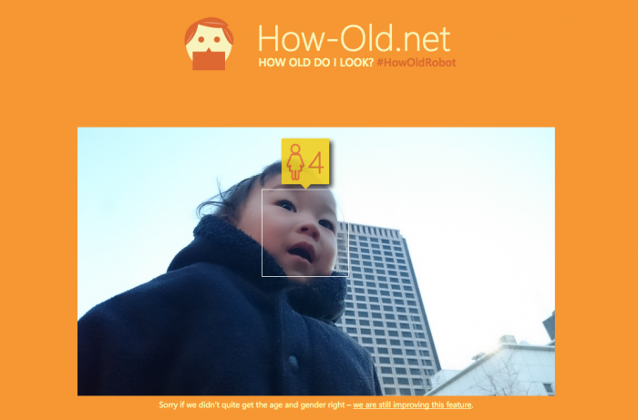
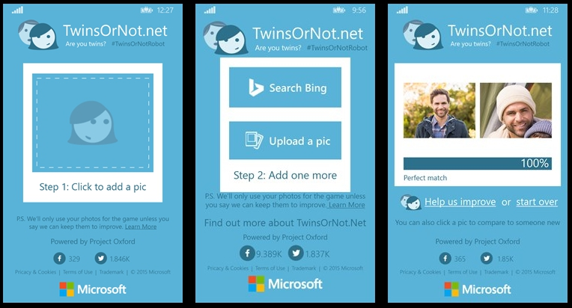
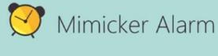
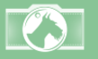
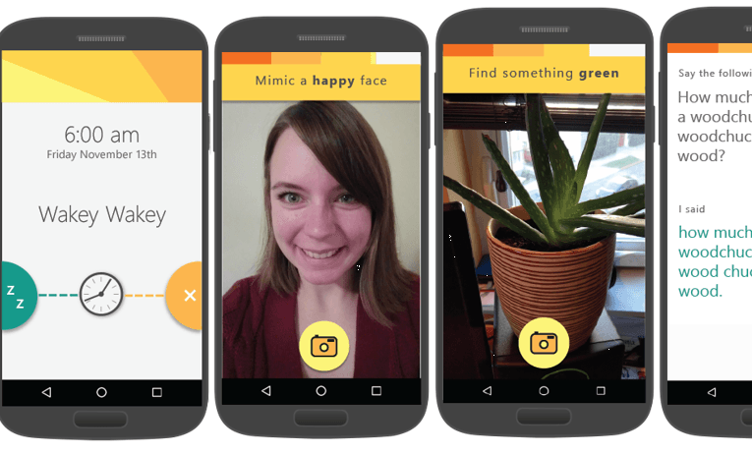

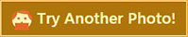



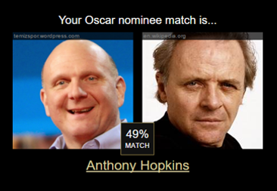


Our Showcase Apps (visit our app catalog at aka.ms/cognitivegallery)
Fetch
CaptionBot.ai
CelebsLike.Me
ProjectMurphy.net
I think it’s a person sitting in front of a computer and he seems ☺. I am 99% sure that’s Bill Gates
“what if Satya Nadella had a long beard?”
Notes:
https://aifunclub.azurewebsites.net/

Slide 10
Vision
Computer Vision API
Face API
Emotion API
Video API
Distill actionable information from images
Detect, identify, analyze, organize, and tag faces in photos
Personalize experiences with emotion recognition
Analyze, edit, and process videos within your app
Notes:
Vision
Computer Vision API: as a free trial on the website microsoft.com/cognitive. There are also SDKs and Samples available on GitHub or through NuGet, Maven, and Cocoapods for select platforms to make development easier. It’s important to note here that it’s not client side running code, but light wrappers around the REST calls to make integration easy.
A photo app would use this as a way to tag user photos and make it easier for users to search through their collections. An assistive app would use this as a way to describe the surroundings to visually-impaired users. Works really well on both indoor or outdoor images; it can recognize common household objects, and it can describe outdoor scenes. However, we did not train on aerial images (say from drones), or on many close ups (so pictures where we zoomed in extremely on the subject won't do well). We also do really well recognizing celebrities (as long as most of the face is visible, and they were facing the camera).
Face API: Some potential uses for this technology include facial login, photo tagging, and home monitoring. Or attribute detection to know age, gender, facial hair, etc.
Emotion API: is available in the Azure marketplace, as a free trial on the website microsoft.com/cognitive. See Computer Vision description.
Build an app that responds to moods. Using facial expressions, this cloud-based API can detect happiness, neutrality, sadness, contempt, anger, disgust, fear, and surprise. The AI understands these emotions based on universal facial expressions, and it functions cross-culturally, so your app will work around the world. Some use cases would be an advertising company wants to test user response to an ad, a tv studio wants to track responses to a pilot.
Video API: as a free trial on the website microsoft.com/cognitive. See Computer Vision description.
It brings Microsoft state of the art video processing algorithms to developers. With Video API, developers can analyze and automatically edit videos, including stabilize videos, create motion thumbnails, track faces, and detect motion. Use cases: For Stabilization: If you have multiple action videos, you can use the stabilization algorithm to make them less shaky and easier to watch. You can also use the stabilization algorithm as a first step in performing other video APIs. For Face Tracking: You can track faces in a video to do A/B testing in a retail setting. You can combine Video API Face Tracking with capabilities in Face API to search through surveillance, crime, or media footage to look for certain person. For Motion Detection: Instead of having to watch long clips of surveillance footage, the API will let you know what time motion occurred and its duration. For Video Thumbnail: Take a long video, such as a keynote presentation, and automatically create a short preview clip of the talk. For Face Tracking: Works best for frontal faces. Currently cannot detect small faces, side or partial faces. For Motion Detection: Detects motion on a stationary background (e.g. fixed camera). Current limitations of the algorithms include night vision videos, semi-transparent objects, and small objects. For Video Thumbnail: Take a long video, such as a keynote presentation, and automatically create a short preview clip of the talk.

Slide 11
Speech
Bing Speech API
Speaker Recognition API
Custom Recognition Intelligent Service
Convert speech to text and back again, and understand its intent
Give your app the ability to know who's talking
Fine-tune speech recognition for anyone, anywhere
Notes:
Speech APIs provide state-of-the-art algorithms to process spoken language powered by Bing. This also includes speech synthesis for a subset of languages supported by speech recognition. With these APIs developers can easily include the ability to add speech driven actions into their applications. In certain cases, the APIs allow for real-time interaction with the user as well. Additional capabilities include voice recognition and speaker identification as well as providing partial transcription, meaning that for supported languages the developer can get partial results before the user has finished speaking. The initial release supports 7 languages.
Bing Speech API: At the time of publication, this data was not available. Please email Rebecca Duffy, reduffy@microsoft.com, if you would like more information.
We also have SDKs available for Speech.
CRIS: The Custom Recognition Intelligent Service (CRIS) enables you to create customized language models and acoustic models tailored to your application and your users. By uploading speech and/or text data to CRIS that reflects your application and your users, you can create custom models that can be used in conjunction with Microsoft’s existing state-of-the-art speech models. To customize the acoustic model to a particular domain, a collection of speech data is required. This collection consists of a set of audio files of speech data, and a text file of transcriptions of each audio file. The audio data should be representative of the scenario in which you would like to use the recognizer. If you were building an app to search MSDN by voice, it’s likely that terms like “object-oriented” or “namespace” or “dot net” will appear more frequently than in typical voice applications. Customizing the language model will enable the system to learn this. CRIS uses acoustic or language model adaptation to enable the speech recognizer to learn the characteristics of the customer’s data while still getting the benefits of all the data and expertise that went into creating the base models that power the Speech API.
For acoustic model adaptation, the technology is described in this paper: http://research.microsoft.com/pubs/194346/0007893.pdf
Works well when the data is uploaded to CRIS is truly representative of the user population and the expected usage of the application. For language model adaptation, it works best when the data uploaded reflects what people would actually say. Uploading simply a list of new terms is better than nothing but will not be as effective. For acoustic model adaptation, if you want to adapt to elderly speech, you need to upload the speech from many different elderly users, not just one or two. If you upload just one person’s voice, CRIS will learn to do a great job on that voice but will not necessarily learn to generalize to other elderly voices. Similarly, if you want to adapt to a new environment, like a factory, you should upload speech data from many speakers in the factory, not just one.
Speaker Recognition API: Microsoft's state-of-the-art cloud-based speaker recognition algorithms to recognize a human's voice in audio streams. It comprises two components: speaker verification and speaker identification. Speaker Verification can automatically verify and authenticate users from their voice or speech. It is tightly related to authentication scenarios and is often associated with a pass phrase. Hence, we opt for text-dependent approach, which means speakers need to choose a specific pass phrase to use during both enrollment and verification phases. Speaker Identification can automatically identify the person speaking in an audio file given a group of prospective speakers. The input audio is paired against the provided group of speakers, and in case there is a match found, the speaker’s identity is returned. It is text-independent, which means that there are no restrictions on what the speaker says during the enrollment and recognition phases. A use case is biometric authentication using voice.
https://blogs.technet.microsoft.com/machinelearning/2015/12/14/now-available-speaker-video-apis-from-microsoft-project-oxford/
We also have SDKs available for Speaker Reco

Slide 12




Speech
Language
Bing Spell Check API
Web Language Model API
Linguistic Analysis API
Language Understanding Intelligent Service
Text Analytics API
Detect and correct spelling mistakes within your app
Leverage the power of language models trained on web-scale data
Easily parse complex text with language analysis
Teach your apps to understand commands from your users
Detect sentiment, key phrases, topics, and language from your text
Notes:
Bing Spell Check API: Microsoft’s state-of-the-art cloud-based spelling algorithms to detect a wide variety of spelling errors and provide accurate suggestions. Using Bing Spell Check, your mobile and PC apps will be powered with state-of-the-art spelling capabilities. Our service is trained on a massive corpus of data gleaned from billions of web pages. There is no need to train your own models. The speller model is updated regularly and incorporates new terms and brands almost as quickly as they appear on the web. This API is available through Microsoft Cognitive Services for customers with low-volume and high-latency jobs. For high-volume and low-latency we have an internal API which may be more suitable. Contact donaldbr directly for more information.
Use cases: 1) Improve the quality of a website's product search 2) provide spell correction for a keyboard app 3) provide spell correction for text fields in an app or web page 4) detect errors in UI text and user data. See https://blogs.msdn.microsoft.com/msr_er/2010/12/15/building-a-better-speller-bing-and-microsoft-research-offer-prizes-for-best-search-engine-spelling-alteration-services/ The speller is exceptional at common spelling errors with low edit-distance (such as febuary->February) but a lot of other spellers are good at that as well. We Do a very good job with word breaking, proper names in context (try "director stephen spielberg") and fictional character names, just a few examples. Areas that are a challenge are capitalization (we don't know what to do with "March" for example, even with context) and consistency (there are times when we will flag a word only intermittently based on the context).
Web Language Model API: Web Language API indexes the web and Bing queries to allow users to calculate the probabilities of natural language expressions and estimate a list of most likely words to follow an existing sequence of words. Use this API to insert spaces into a string of words without spaces, like a hashtag or URL. Use this API to rerank machine translation/speech recognition candidate sentences based on probability of the sentence.
Use this API for academic research. http://research.microsoft.com/apps/pubs/default.aspx?id=130762
We also have SDKs available for WebLM
Linguistic Analysis API: The Linguistic Analysis API helps you gain insights from text. Given a natural language parse, it’s easy to identify the concepts and entities (noun phrases), actions (verbs and verb phrases), descriptive words, and more. The processed text can provide useful features for classification tasks such as sentiment analysis.
We also have SDKs available for Linguistic Analysis.
LUIS: Language Understanding Intelligent Service (LUIS) allows developers to build a model that understands natural language and commands tailored to their application. Example: You can say “turn down the thermostat in the living room,” send it to a LUIS model, and instead of just returning the text that represents what was said, LUIS will return: the action is “turn down,” the location is “living room,” and the target is “thermostat.” LUIS allows developers to iteratively build on these models and take speech or text input and return a structured representation of what the person said. Not only that but by build LUIS will help developers create and train smart conversational bot (Intercom or Slack) with a single button. LUIS will also offer action fulfillment capabilities by simple integration with webhooks. LUIS works pretty well it comes to intents. For the entities, the learning curve is slower especially when the number of entities increases. LUIS only supports 20 intents & 10 entities yet by build each entities can have up to 10 children.
Text Analytics API: At the time of publication, this data was not available. Please email Rebecca Duffy, reduffy@microsoft.com, if you would like more information.

Slide 13

Language
Knowledge
Academic Knowledge API
Knowledge Exploration Service
Entity Linking Service
Recommendations API
Explore relationships among academic papers, journals, and authors
Add interactive search over structured data to your project
Contextually extend knowledge of people, locations, and events
Provide personalized product recommendations for your customers
Notes:
Academic Knowledge API: The Academic Knowledge API enable developers to interpret user queries for academic intent and retrieve rich entity information about research papers, authors, journals, conferences, and universities from the Microsoft Academic Graph (MAG). 1. Developers can use this API to build search features such as the knowledge-based query auto-suggest and search results at http://academic.microsoft.com. 2. Universities can retrieve analytics data about their researchers' publications, topics, and venues. 3. Conference organizers can analyze the citation patterns of their conference papers. 4. Data scientists and computer science researchers can develop new ranking and analysis approaches over a large heterogeneous network.
A publication about our approach can be found here: http://research.microsoft.com/apps/pubs/default.aspx?id=246609 The underlying data graph (Microsoft Academic Graph) is constructed over discovered academic papers on the web. The data is largely unstructured, of variable quality, and ambiguous. We are constantly working to improve this data quality and to correctly aggregate the multiple instances of authors, papers, etc. into a single representative entity in the graph.
Knowledge Exploration Service API: Enable interactive search experience over structured data via natural language. Indexes customer's structured data (BYOD) with support for prefix completion. Generates annotated interpretations/completions of natural language queries. Publishers/libraries can use this to create interactive search over their publications similar to academic.microsoft.com. Merchants can create interactive search experience to help users find and discover products. Data owners can create systems that answer natural language user questions. It works best when the structured data is clean and the natural language structure is simple and predictable. Otherwise, customers will have to invest a bit of work to generate the structured data and author the grammar. We are working on future components to simplify both authoring aspects.
Entity Linking Service API: Given a specific paragraph of text within a document, the Entity Linking will recognize and identify each separate entity based on the context and linking the entity to wikipedia. Use cases: A news agency would use this to analysis their news article to create relations between articles, a news agency would use this to generate tags for article and make recommendation for reader, a company would use this to track the PR articles mentioned it and product comments to track customer feedback. We also have SDKs available for Entity Linking.
Recommendations API: At the time of publication, this data was not available. Please email Rebecca Duffy, reduffy@microsoft.com, if you would like more information.

Slide 14
Search
Knowledge
Bing Web Search API
Bing Autosuggest API
Bing Image Search API
Bing Video Search API
Bing News Search API
Connect powerful search to your apps
Give your app intelligent autosuggest options for searches
Bring advanced image and metadata search to your app
Trending videos, detailed metadata, and rich results
Link your users to robust and timely news searches
Notes:
The Search APIs provide access to the search technology that power Bing.com and a long list of 1st-party (Office, Cortana, Xbox, Edge) and 3rd-party (AOL, Apple, Amazon, Yahoo etc.) partners. In total, we have 4 Search APIs for web, image, video and news search. In addition we provide access to our Autosuggest (type-ahead) and Spell Check services.
Bing Web Search API: is the main Search API. With one programmatic call, the user can get back relevant webpage, image, video, and news results. It's equivalent to searching in the web vertical in bing.com. The Search APIs provide the power of the Bing Search engine to developers. You get access to many of the latest and greatest capabilities the bing.com site has to offer, in the form of an API. It's the same architecture stack so it's a powerful way to bring the knowledge and intelligence of the search engine to your own experience. The API is built directly on top of the entire Bing stack- you get the quality, relevance, performance and continuous improvements that the rest of the site gets. Similar to Bing.com- tail queries, or obscure terms may have limited results. We're always working to improve the edge cases though and API users will benefit from that.
Bing Autosuggest API: At the time of publication, this data was not available. Please email Rebecca Duffy, reduffy@microsoft.com, if you would like more information.
Bing Image Search API: At the time of publication, this data was not available. Please email Rebecca Duffy, reduffy@microsoft.com, if you would like more information.
Bing Video Search API: At the time of publication, this data was not available. Please email Rebecca Duffy, reduffy@microsoft.com, if you would like more information.
Bing News Search API: At the time of publication, this data was not available. Please email Rebecca Duffy, reduffy@microsoft.com, if you would like more information.

Slide 15

Demonstrations
Intelligent Kiosk
Notes:
Kiosk Demonstration : https://aka.ms/kioskapp
Kiosk Script : https://aka.ms/kioskscript
You can also find the following interactive demonstrations in the Cognitive Services Site :
Vision
Computer Vision
Emotion
Face
Video
Speech
Bing Speech
Custom Recognition
Speaker Recognition
Language
Bing Spell Check
Language Understanding
Linguistic Analysis
Text Analytics
WebLM
Knowledge
Academic
Entity Linking
Knowledge Exploration
Recommendations
Search
Bing Web Search
Bing Image Search
Bing Video Search
Bing News Search
Bing Autosuggest

Slide 16
Vision
From faces to feelings, allow your apps to understand images and video
Computer Vision | Emotion | Face | Video

Slide 17

Computer Vision APIs
Analyze an image Understand content within an image
OCR Detect and recognize words within an image
Generate thumbnail Scale and crop images, while retaining key content
Recognize Celebrities Thanks to domain specific models, ability to recognize 200K celebrities from business, politics, sports and entertainment around the World.
Notes:
Do you need an API that gives you actionable information about images used in your app? The Computer Vision API gives you the tools to understand the contents of any image. Create tags identifying objects, beings, or actions present in the image, and then craft coherent sentences to describe it. Whether you want to execute better image search, or you want to create an assistive app for the visually impaired, the Computer Vision API helps get the job done.

Slide 18
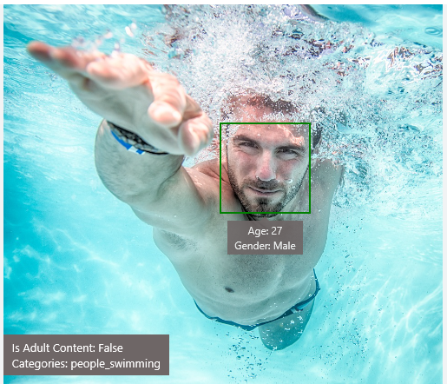
Analyze image
Night Club
Type of image
Clip Art Type 0 Non-clipart
Line Drawing Type 0 Non-Line Drawing
Black & White Image False
Content of image
Categories [{ “name”: “people_swimming”, “score”: 0.099609375 }]
Adult Content False
Adult Score 0.18533889949321747
Faces [{ “age”: 27, “gender”: “Male”, “faceRectangle”: {“left”: 472, “top”: 258, “width”: 199, “height”: 199}}]
Image colors
Dominant Color Background White
Dominant Color Foreground Grey
Dominant Colors White
Accent Color
Notes:
Nightclub-
Face of listed band users – bad people at night clubs or casinos or VIPS
Ratio of men vs women

Slide 19

OCR
Good at
JSON:
{
"language": "en",
"orientation": "Up",
"regions": [
{
"boundingBox": "41,77,918,440",
"lines": [
{
"boundingBox": "41,77,723,89",
"words": [
{
"boundingBox": "41,102,225,64",
"text": "LIFE"
},
{
"boundingBox": "356,89,94,62",
"text": "IS"
},
{
"boundingBox": "539,77,225,64",
"text": "LIKE"
}
. . .
Scanned documents
Photos with text
Fine grained location information
LIFE IS LIKE
RIDING A BICYCLE
TO KEEP YOUR BALANCE
YOU MUST KEEP MOVING

Slide 20




Smart thumbnail
Smart cropping on
Smart cropping off

Slide 21


“I have not seen anything comparable. We can use the Computer Vision API to prove to our clients the reliability of the data, so they can be confident making important business decisions based on that information.”
Vigiglobe CEO Leendert de Voogd
Computer Vision API
Read Case Study Here
Notes:
Vigiglobe
Vigiglobe saw an opportunity to analyze not only what was being said on social media, but also the context in which it was being discussed. The team created proprietary algorithms to accurately interpret and contextualize social media messages in real time. Using the Computer Vision API of Microsoft

Slide 22


“Thousands of partners sign in to our platform every hour. The response time from the Face API is incredible, enabling us to verify our drivers without slowing them down.”
Dima Kovalev, Product Manager, Uber
Face API
Read Case Study Here
See Video Here
Notes:
Summary
Millions of people worldwide have embraced Uber as a new means of reliable transportation and flexible income. To safeguard against fraud and enhance both driver and rider peace of mind, Uber uses the Face API, part of Microsoft Cognitive Services, to help ensure the driver using the app matches the account on file. The extra verification step is fast, works on all smartphones and in dim light, and scales to more than 1 million driver-partners. By using the Face API, Uber saved months of development work, time it could devote to tailoring the user experience.
Challenge
Uber sends photos of drivers to riders as soon as their ride is on the way, but occasionally the Uber driver who shows up doesn’t look like the person in the photo that the rider receives. Uber wanted to make sure that the person it had screened and approved was the person behind the wheel.
Solution
Uber decided to use photo-matching to verify drivers when they signed in to the Uber app. Drivers would periodically take and submit a selfie to verify their identity. Uber used the Microsoft Cognitive Services Face API to build its Real-Time ID Check feature. The Face API supported the ability to compare photos in varying pose, focus, and lighting conditions.
Benefits
Three-week development time and rapid time-to-market with new driver authentication step
Amazing performance, which provides quick authentication without slowing down drivers
Very high photo-matching accuracy
Scalable to support up to 1 million users
https://customers.microsoft.com/en-US/story/uber

Slide 23

Bringing it all together
The Seeing AI App
Computer Vision, Image, Speech Recognition, NLP, and ML from Microsoft Cognitive Services
Read Blog Here
Watch Video Here
Notes:
Here’s a preview of the Seeing AI app, which started as a research project that helps people who are visually impaired or blind to understand who and what is around them.
The app will use computer vision, image & speech recognition, natural language processing and machine learning from Microsoft Cognitive Services. The app is under development and is not available today but it shows what’s possible with the APIs.

Slide 24

Recognize emotions Detect emotions based on facial expressions in photos and videos
Emotion APIs
Notes:
How are you feeling? Can your app tell? With the Emotion API, you can build an app that recognizes emotions according to facial expressions—giving you the capability to provide an amazing, personalized experience.
Using facial expressions, this cloud-based API can detect happiness, neutrality, sadness, contempt, anger, disgust, fear, and surprise. The AI understands these emotions based on universal facial expressions, and it functions cross-culturally, so your app will work around the world.

Slide 25
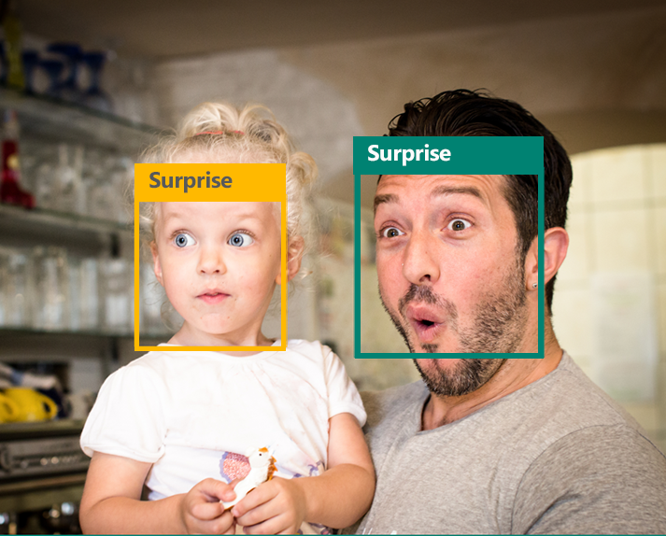
Emotion APIs
Face detection
"faceRectangle": {"width": 193, "height": 193, "left": 326, "top": 204} …
Emotion scores
“scores": { "anger": 5.182241e-8,
"contempt": 0.0000242813,
"disgust": 5.621025e-7,
"fear": 0.00115027453,
"happiness": 1.06114619e-8,
"neutral": 0.003540177,
"sadness": 9.30888746e-7,
"surprise": 0.9952837}

Slide 26

Face APIs
Face detection Detect faces and their attributes within an image
Face verification Check if two faces belong to the same person
Similar face searching Find similar faces within a set of images
Face grouping Organize many faces into groups
Face identification Search which person a face belongs to
Notes:
Detect human faces and compare similar ones, organize people into groups according to visual similarity, and identify previously tagged people in images.

Slide 27




Face APIs
Detection
"faceRectangle": {"width": 193, "height": 193, "left": 326, "top": 204}
…
Feature attributes
"attributes": { "age": 42, "gender": "male",
"headPose": { "roll": "8.2", "yaw": "-37.8", "pitch": "0.0" }}
Grouping
Identification
Jasper Williams

Slide 28


Video APIs
Stabilization Smooth and stabilize shaky video
Face detection and tracking Detect and track faces in videos
Motion detection Detect when motion occurs
Notes:
Intelligent video processing produces stable video output, detects motion, creates intelligent thumbnails, and detects and tracks faces.

Slide 29
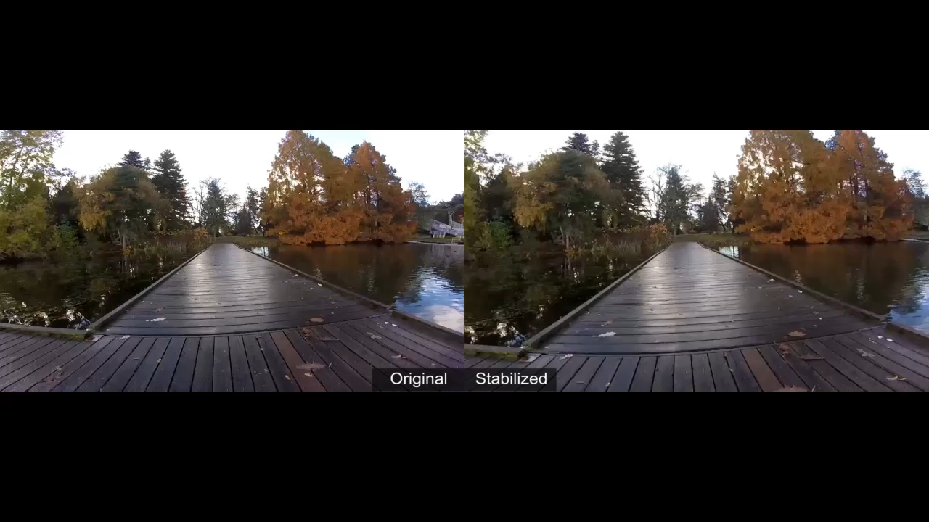
Stabilization
The Stabilization API provides automatic video stabilization and smoothing for shaky videos
This API uses many of the same technologies found in Microsoft Hyperlapse
Best For: Small camera motions, with or without rolling shutter effects (e.g., holding a static camera, walking with a slow speed)

Slide 30
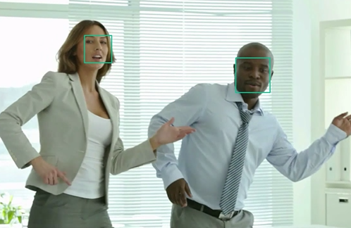
Face detection and tracking
High precision face location detection and tracking
Can detect up to 64 human faces in a video (no smaller than 24x24 pixels)
Detected and tracked faces are returned with coordinates and a Face ID to track throughout the video
Time (sec) | Face ID | x, y | Width, height
0 | 0 | 0.59, 0.23 | 0.09, 0.16
0 | 1 | 0.38, 0.15 | 0.07, 0.12
1 | 0 | 0.54, 0.25 | 0.09, 0.15
1 | 1 | 0.23, 0.18 | 0.07, 0.12

Slide 31
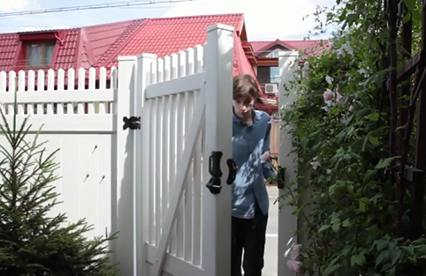
Motion detection
Indicates when motion occurs against a fixed background (e.g., surveillance video)
Trained to reduce false alarms, such as lighting and shadow changes
Current limitations:
No support for night-vision videos
Semi-transparent and small objects are not detected well
Start time | End time | In region
1.9 | 3.6 | 0
5.2 | 15.1 | 0

Slide 32
Speech
Hear and speak to your users by filtering noise, identifying speakers, and understanding intent
Custom Recognition | Speaker Recognition | Speech

Slide 33

Speech APIs
Voice recognition (speech to text) Converts spoken audio to text
Voice output (text to speech) Synthesize audio from text
Speech intent recognition Convert spoken audio to intent
Notes:
Convert audio to text, understand intent, and convert text back to speech for natural responsiveness.
Speech Intent Recognition can, in addition to returning recognized text from audio inputs, also return structured information about the speech to apps that parse the intent of the speaker and drive further actions by the app. Models trained by LUIS service are used to generate the intent.

Slide 34
Voice recognition
REST API
Client library
SUPPORTED PLATFORMS
Any
Windows, Android, iOS
DATA SUPPORT
Yes
Yes
MIC SUPPORT
No
Yes
SILENCE DETECTION ON MIC
No
Yes
LENGTH OF UTTERANCE
Short
Short and long
NUMBER OF RESPONSES
n-best response back
Multiple partial results, n-best (short), and multiple phrases (long)
Supports 7 languages: en-US, en-GB, zh-CN, it-IT, fr-FR, es-ES, de-DE
Same technology that supports Microsoft offerings of Xbox, Windows, and Cortana

Slide 35
Voice recognition
Short form
Long form
Duration of Audio | < 15 seconds | < 2 minutes
Final Result | n-best choice | Best choice, delivered at sentence pauses
Partial Results | Yes | Yes
450 6th St. San Francisco
********* Final N-BEST Results *********
[0] Confidence=Normal Text="450 six St San Francisco."
[1] Confidence=Normal Text="For 50 six St San Francisco."
[2] Confidence=Normal Text="456th St San Francisco."
[3] Confidence=Normal Text="450 six St in San Francisco."
[4] Confidence=Normal Text="456 St San Francisco."

Slide 36
Voice output
Synthesize audio from text via POST request
Maximum audio return of 15 seconds
17 languages supported
<speak version="1.0" xmlns="http://www.w3.org/2001/10/synthesis" xmlns:mstts="http://www.w3.org/2001/mstts" xml:lang="en-US">
<voice name="Microsoft Server Speech Text to Speech Voice (en-US, ZiraRUS)">
Synthesize audio from text, to speak to your users.
</voice></speak>
Synthesize audio from text, to speak to your users

Slide 37


“Microsoft Cognitive Services gives us a huge range of opportunities. It’s a perfect match for us now, and in the future when we want to add more features to our app. The Computer Vision and Speech APIs are extremely powerful.”
Blucup CEO Jaan Apajalahti
Computer Vision API and Speech API
Read Case Study Here
Notes:
Blucup
Finland-based Blucup was on a mission to solve a common problem: how can salespeople capture data while on the go? The company developed the Zero Keyboard app, which sales reps could use to record customer information quickly and add it automatically to their customer relationship management (CRM) systems using touch gestures, voice, and pictures. Using the Speech and Computer Vision APIs from Microsoft Cognitive Services, Blucup provides customers with accurate results and rich features—all while speeding development internally.

Slide 38

Custom Recognition
Customize both language and acoustic models Tailor speech recognition to your app and environment
Notes:
Eliminate speech recognition barriers like speaking style, background noise, and vocabulary.
Does your speech recognition work with varied user populations, vocabularies, or with background noise? The Custom Recognition Intelligent Service (CRIS) helps you create custom speech recognition endpoints—so accents and environments are features, not challenges.
Customize your speech recognition by vocabulary and speaking style, create custom acoustic models to match the expected environment of your users, and tap into the API's powerful intelligence to create speech recognition endpoints customized to your app's needs. Turn language barriers into features with CRIS.

Slide 39
Custom Recognition Intelligent Service
Create custom language models for the vocabulary of the application
Adapt acoustic models to better match the expected environment of the application’s users
Deploy to a custom endpoint and access from any device
Record
audio
Adapt
Deploy
Transcribe

Slide 40
Speaker recognition API
“”
Speaker verification Check if two voices are the same
Speaker identification Identify who is speaking
Notes:
Your users' voices are their passports with the Speaker Recognition API. Your app can authenticate identities by using someone's voice, giving your users the capability to interact securely through speech.

Slide 41
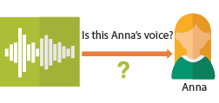
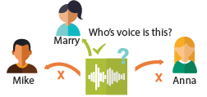
Speaker recognition APIs
“”
Enrollment
Create a unique voiceprint for a profile
Is this Anna’s voice?
Recognition
After enrolling one or more voices, identify who is speaking from an audio clip
Anna
Verification
Who’s voice is this?
Confirm if a voice belongs to a previously enrolled profile
Marry
Mike
Anna

Slide 42
Language
Process text and learn how to recognize what users want
Bing Spell Check | Language Understanding | Linguistic Analysis | Text Analytics | Web Language Model

Slide 43

Bing spell check APIs
State-of-the-art cloud based spelling algorithms Recognizes a wide variety of spelling errors
Recognize name errors and homonyms in context Difficult to spot errors that use the context of the words around them
Updates over time Support for new brands and coined expressions as they emerge
Notes:
The Bing Spell Check API corrects spelling errors, contextually recognizes names and slang, understands homonyms, and supports brand names.

Slide 44



Bing spell check APIs
Check a single word or a whole sentence
“Our engineers developed this four you!”
Corrected Text: “four” → “for”
Identify errors and get suggestions
"spellingErrors": [
{
"offset": 5,
"token": "gona",
"type": "UnknownToken",
"suggestions": [
{ "token": "gonna" }
] }

Slide 45

Language Understanding
Understand what your users are saying Use pre-built Bing and Cortana models or create your own
Notes:
Understand language contextually, so your app communicates with people in the way they speak.
Do your apps understand language in the way people speak it—contextually? With the Language Understanding Intelligent Service (LUIS) API, you can integrate language models that understand your users quickly and easily. And if one of our preexisting models won't work, it will guide you through building your own.
Prebuilt models will recognize places, times, numbers, and temperatures, and handle common requests like "set an alarm for 8 AM." LUIS supports dialogue and action fulfillment, so your users can carry on a conversation with your app. For example, the input "schedule a meeting with Allison" results in the question "when?," allowing the user to respond "3 PM," and the meeting gets scheduled.

Slide 46
Language understanding intelligent service
Reduce labeling effort with interactive featuring
Use visualizations to gauge performance and improvements
Leverage speech recognition with seamless integration
Deploy using just a few examples with active learning
Define
concepts
Provide
examples
Deploy
Active learning

Slide 47
Language understanding models
{
“entities”: [
{
“entity”: “flight_delays”,
“type”: “Topic”
}
],
“intents”: [
{
“intent”: “FindNews”,
“score”: 0.99853384
},
{
“intent”: “None”,
“score”: 0.07289317
},
{
“intent”: “ReadNews”,
“score”: 0.0167122427
},
{
“intent”: “ShareNews”,
“score”: 1.0919299E-06
}
]
}
“News about flight delays”

Slide 48
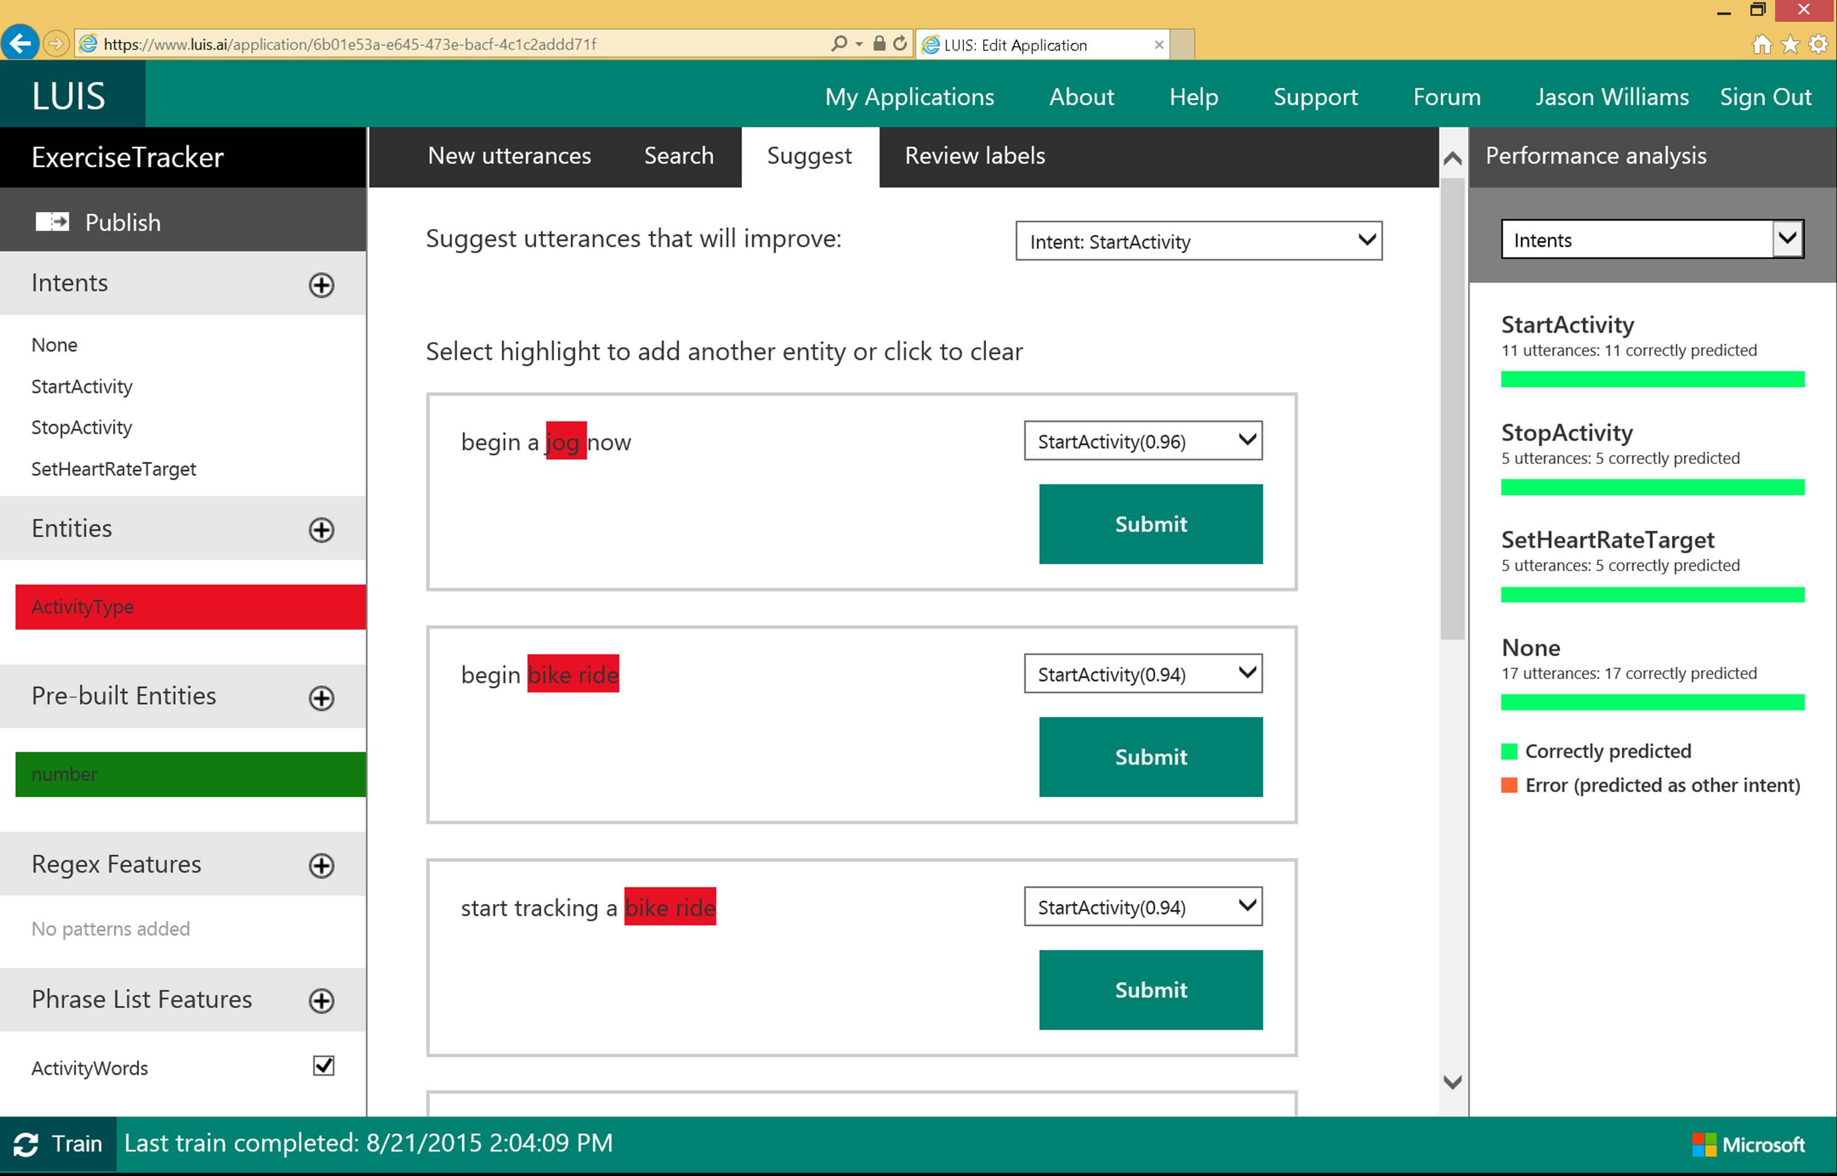

Slide 49

Linguistic analysis
Analysis tolls for natural language processing Access to part-of-speech tagging and parsing, identifying concepts, and actions
Notes:
You know what your users are saying, but do you know what it means? The Linguistic API uses advanced linguistic analysis tools for natural language processing, giving you access to part-of-speech tagging and parsing. These tools allow you to hone in on important concepts and actions. The API can tap into traditional linguistic analysis tools that allow you to identify the concepts and actions in your text with part-of-speech tagging, and find phrases and concepts using natural language parsers. Whether you’re mining customer feedback, interpreting user commands, or consuming web text, understanding the structure of the text is a critical first step. Try it out below!

Slide 50
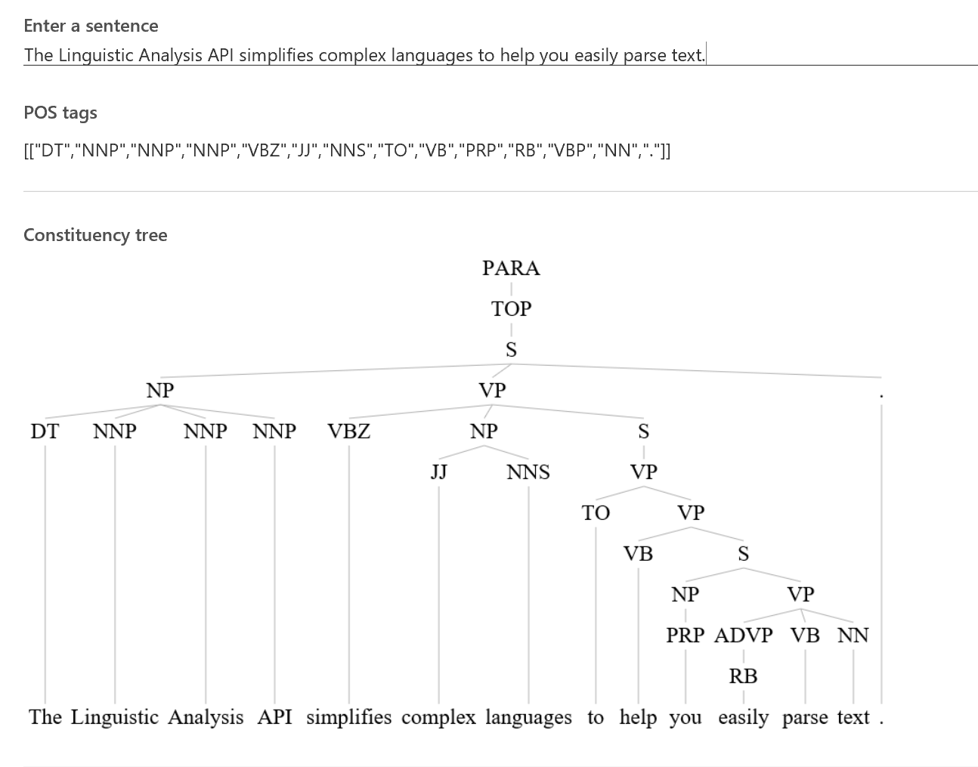
Linguistic Analysis

Slide 51

Text analytics
Sentiment analysis Understand if a record has positive or negative sentiment
Key phrase extraction Extract key phrases from a piece of text, and retrieve topics
Topic detection Use clustering techniques to identify the trending topics on a large set of text records
Language detection Identify the language, 120 supported languages
Notes:
Understanding and analyzing unstructured text is an increasingly popular field and includes a wide spectrum of problems such as sentiment analysis, key phrase extraction, topic modeling/extraction, aspect extraction and more.

Slide 52
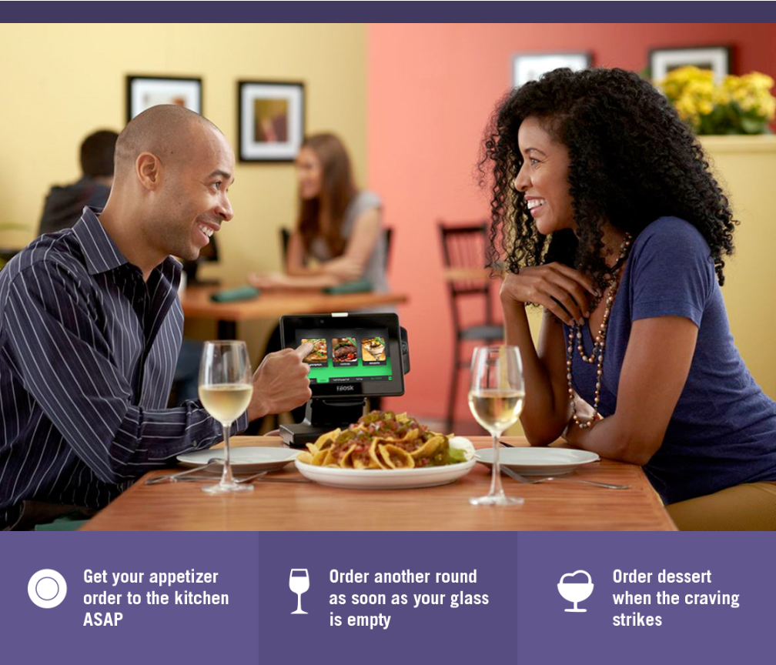

“Thanks to Text Analytics by Azure Machine Learning, we’re able to incorporate guest sentiment into our actionable guest feedback platform to deliver a comprehensive view of guest satisfaction and server performance.”
Al Pappa
Head of Business Intelligence Ziosk
Text Analytics API
Notes:
Case study coming soon

Slide 53

Web language model
Automation of a variety of standard natural language processing tasks using state-of-the-art language modeling APIs
Word breaking, joint probability of natural language expressions, scoring, and predicting following words in a sequence
Notes:
Automate a variety of standard natural language processing tasks using state-of-the-art language modeling APIs.
Do you need to know how frequently certain words appear together? Or figure out which words a user might type next? Or how to break a hashtag into individual words? The Web Language Model API lets your app do all of this quickly and accuratel.

Slide 54
Knowledge
Tap into rich knowledge amassed from the web, academia, or your own data
Academic Knowledge
Entity Linking | Knowledge Exploration
Recommendations

Slide 55

Academic knowledge
Interpret Interprets a natural language user query string. Returns annotated interpretations which can enable rich search-box auto-completion experiences that anticipate what the user is typing
Evaluate Evaluates a query expression and returns academic knowledge entity results
Calchistogram Calculates a histogram of the distribution of attribute values for the academic entities returned by a query expression, such as the distribution of citations by year for a given author
Notes:
Tap into the wealth of academic content in the Microsoft Academic Graph using the Academic Knowledge API.
Do your users know who the top scholars have been in machine learning over the last three years? What about every paper authored by an expert like Li Deng from Microsoft? The Academic Knowledge API answers these and other questions by applying the Knowledge Exploration Service to the Microsoft Academic Graph. Users can start from natural language queries, or you can ping the graph directly through structured query expressions.
Additionally, the Academic Knowledge API can auto-complete natural language queries and return entity results, helping users narrow research results faster.
It can also create a histogram of attribute values for academic entries returned by a query—for example, the distribution of papers by year for an author.
Limitation: pre-trained on academic data. So you can not go harvest pubmed.

Slide 56

Entity linking
Power your app's data links with named entity recognition and disambiguation A word might be used as a named entity, a verb, or another word form within a given sentence
The Entity Linking Intelligence Service will recognize and identify each separate entity based on the context
Notes:
Provide better user experiences by adding the Entity Linking Service to your app so that it can provide additional knowledge and facts from the web to supplement the text in context. The Entity Linking Service uses a prebuilt knowledge base to build links, and the option to acquire knowledge from your own data.
For example, your app may need to understand that "London, the capital" is the city of
London in the United Kingdom and not London, Ontario, or Jack London, the author.
The Entity Linking Service provides this information quickly and within context, offering a faster, more intelligent user experience.

Slide 57

Knowledge exploration Enable interactive search experiences over structured data via natural language inputs
Attribute histograms To enable rich visualization and interactive faceted experience
Structured query evaluation To efficiently retrieve detailed information about matching objects
Query auto-completion
To reduce user effort and help with discovery of rich capabilities
Natural language understanding
To interpret natural language queries into structured query expressions
Notes:
Do you have structured data for users to explore via natural language? The Knowledge Exploration Service takes structured data and linguistic resources you provide and creates a service that enables interactive search.
For example, as your users enter queries in a search box, the Knowledge Exploration Service offers auto-complete suggestions and semantic annotations. You can retrieve the top matching objects from the data, and you can create histograms of attribute values among the matches.

Slide 58


Recommendations
Increase catalog discovery Help customers easily discover items that they may be interested in
Personalize your experience Show suggestions that are targeted to each specific user
Increase the bottom line Increase your conversion rate by offering the right products at the right time
Notes:
The Recommendations API helps your customer discover items in your catalog.
Customer activity in your digital store is used to recommend items and to improve conversion in your digital store.
The recommendation engine may be trained by uploading data about past customer activity or by collecting data directly from your digital store. When the customer returns to your store you will be able to feature recommended items from your catalog that may increase your conversion rate.

Slide 59


“By leveraging Cortana Intelligence Recommendations capabilities combined with Azure Machine Learning processing power, we have enabled retailers with a Personalized Commerce Experience, allowing them to grow shopper engagement and conversions across all channels.”
Frank Kouretas, Chief Product Officer at Orckestra
Orckestra.com
Recommendations API
Notes:
Case study coming soon

Slide 60


The Recommendations API allows Allrecipes.com to harness billions of user-shared experiences to deliver highly personalized recipe solutions that answer busy families most pressing question, ‘What’s for dinner tonight?’
We are able to do this with minimal investment due to the proven capabilities of the Cortana Analytics platform. This helps us further realize our vision of providing highly personalized cooking inspiration for home cooks.
John Keane CTO, Allrecipes.com
Recommendations API
Notes:
Case study coming soon

Slide 61
Search
Access billions of web pages, images, videos, and news with the power of Bing APIs
Bing Web Search | Bing Image Search
Bing News Search | Bing Video Search
Bing Auto Suggest

Slide 62

Bing web search
Intelligent search to your apps with the ability to comb billions of webpages, images, videos, and news with a single API call Retrieve web documents indexed by Bing and narrow the results down with filters such as by answer type and freshness
Notes:
The Bing Search API adds intelligent search to your app, combing hundreds of billions of webpages, images, videos, and news to provide relevant results with no ad requirements. The results can be automatically customized to your users' locations or markets, increasing relevancy by staying local.

Slide 63

Bing image search
A variety of image search options, from trending images to detailed insights Scour the web for images and get results that include thumbnail and full image URLs, publishing website, image metadata, related images, and more
What if – Murphy bot
Notes:
The Bing Image Search API gives you powerful image searching tools with a single call. You can tap into trending images of people, places, and things from around the world, and filter results by image style, size, layout, date added, and license type.

Slide 64

Bing video search
A variety of advanced video search features, including trending videos, price, and other useful metadata Find videos from across the web and get responses that provide useful metadata including creator, encoding format, video size and quality, and source view count
Notes:
The Bing Video Search API offers robust video searching features with a single API call. You can receive information from around the world about trending videos, updated on a daily basis. Search results can be returned by either a static image or a motion thumbnail, allowing you to customize how your users see what they're looking for.

Slide 65

Bing news search
Turn any app into a news desk with world news grouped and filtered by topic, local news, and metadata you can mine
Notes:
The Bing News Search API can help turn your app into an up-to-date news center. Results from a single call bring trending news from around the world, which is updated in near-real time, so users can be kept up to date on whatever's happening in their neighborhood—or across the globe.

Slide 66

Bing auto suggest
[
Query completion suggestions capabilities, so users can type less and get to what they want faster
Notes:
Whether you're searching the web, a local set of data, or just asking users to enter an input into your app, the Bing Autosuggest API helps narrow the search quickly by allowing your users to see suggestions for popular search terms. It can correct perceived mistakes, and returns detailed contextual suggestions according to other searches people have found useful.

Slide 67

Get started for free at http://microsoft.com/Cognitive
Learn more on the Cortana Intelligence Suite website and Cognitive Services website
Schedule a workshop to identify areas in your business where analytics and intelligence can drive transformation
Talk with your Microsoft contact about licensing options and partners

Slide 68
Pricing
https://azure.microsoft.com/en-us/pricing/details/cognitive-services/
Documentation
https://www.microsoft.com/cognitive-services/en-us/computer-vision-api/documentation
Demos
Kiosk Demonstration : https://aka.ms/kioskapp
Kiosk Script : https://aka.ms/kioskscript
Client SDKs
https://github.com/Microsoft/ProjectOxford-ClientSDK
https://github.com/felixrieseberg/project-oxford (nodejs)
https://github.com/southwood/project-oxford-python
Example Code
https://github.com/jsturtevant/happy-image-tester-django
https://github.com/jsturtevant/happy-image-tester-nodejs
Community
https://stackoverflow.com/questions/tagged/microsoft-cognitive
https://social.msdn.microsoft.com/forums/azure/en-US/home?forum=mlapi
https://cognitive.uservoice.com/
Developer Resources
Notes:
Access to strong documentation, sample code and community resources is critical for developers to be able to understand and become users of Cognitive Services. Customize these links based on your own resources or use the ones listed here.

Slide 69
Q&A

Slide 70

© 2016 Microsoft Corporation. All rights reserved.

Slide 71
Appendix

Slide 72
Cognitive services
“Enable your apps to see, hear, interpret, and interact in more human ways.”
Vision
Speech
Language
Knowledge
Search

Slide 73
Cognitive services
Vision
Speech
Language
Knowledge
Search
Computer vision
Face
Emotion
Video
Speaker recognition
Speech
Custom recognition
Text analytics
Bing spell check
Web language model
Linguistic analysis
Language understanding
Translator
Academic knowledge
Entity linking service
Knowledge exploration service
Recommendations
Bing search API
Bing image search API
Bing video search API
Bing news search API
Bing auto suggest API
Vision
Speech
Language
Knowledge
Search
Notes:
Vision Category : From faces to feelings, these APIs allow your apps to understand image and video content.
Speech Category : Hear and speak to your users with APIs that filter noise, identify speakers, and more.
Language Category : APIs that allow your apps to process natural language and learn how to recognize what users want.
Knowledge Category : Tap into rich knowledge amassed from the web, academia, or your own data. Processing complex information in order to identify patterns.
Search Category: Make your apps more intelligent with the power of Bing APIs. A single call accesses data from billions of web pages, images, videos, and news.

Slide 74

Microsoft Cognitive Services
democratizing intelligence
Notes:
So, what are Cognitive Services? Cognitive Services are a collection of artificial intelligence APIs, and we believe in democratizing artificial intelligence. So what that means is, regardless of your skill level -- whether you're a high school student running your first program or working in industry or in a giant enterprise -- that you should be able to use our APIs incredibly quickly in a matter of minutes.
And regardless of your platform -- whether you're on Android or IOS or Windows, or making a website -- all of our APIs are rest APIs, which means you can call them as long as you have an Internet connection. And so that's pretty huge because what we're doing is making it so that everyone can build these smarter, more context-aware applications.
The technology used in our APIs is the same technology that powers our products today. And so, when you think of things like the Bing search APIs, it's the same technology from Bing.
Today I’m going to talk with you about the entire collection spanning vision, speech, language, knowledge, and search.
The other things that I want to point out is that you can get started for free with all of the APIs, but we do have pricing available for a number of them, which are in public preview on Azure.
The other piece is the developer resources. So, all of our documentation is on the website and actually in GitHub as well, so we do welcome community submissions. We have a set of SBKs that are also available on GitHub where we welcome poll requests and post everything on there. The SBKs vary from API to API, but they are all included in this one repository for people to see.
And then we have three different communities that we support. We have our MSDN forums, our Stack Overflow, and we have User Voice that we use for feedback requests.

Slide 75
Why Microsoft Cognitive Services?
Easy
Flexible
Tested
Roll your own with REST APIs
Simple to add: just a few lines of code required
Integrate into the language and platform of your choice
Breadth of offerings helps you find the right API for your app
Built by experts in their field from Microsoft Research, Bing, and Azure Machine Learning
Quality documentation, sample code, and community support
GET A KEY
BUILD
Notes:
Why choose these APIs? They work, and it’s easy.
Easy: The APIs are easy to implement because of the simple REST calls. Being REST APIs, there’s a common way to implement and you can get started with all of them for free simply by going to one place, one website, www.microsoft.com/cognitive. (You don’t have to hunt around to different places.)
Flexible: We’ve got a breadth of intelligence and knowledge APIs so developers will be able to find what intelligence feature they need; and importantly, they all work on whatever language, framework, or platform developers choose. So, devs can integrated into their apps—iOS, Android, Windows—using their own tools they know and love (such as python or node.js, etc.).
Tested: Tap into an ever-growing collection of powerful AI algorithms developed by experts. Developers can trust the quality and expertise build into each API by experts in their field from Microsoft’s Research organization, Bing, and Azure machine learning and these capabilities are used across many Microsoft first party products such as Cortana, Bing and Skype.

Slide 76
Vision
From faces to feelings, allow your apps to understand images and video
Microsoft Cognitive Services
Give your apps a human side
Speech
Hear and speak to your users by filtering noise, identifying speakers, and understanding intent
Language
Process text and learn how to recognize what users want
Knowledge
Tap into rich knowledge amassed from the web, academia, or your own data
Search
Access billions of web pages, images, videos, and news with the power of Bing APIs
Notes:
What are Cognitive Services? Microsoft Cognitive Services are a new collection of intelligence and knowledge APIs that enable developers to ultimately build smarter apps.
NOTES: key concepts we are trying to convey in this above statement:
That we are bringing together Intelligence (Oxford) and Knowledge from the corpus of the web (Bing)
That cognitive = human perception and understanding, enabling your apps to see the world around them, to hear and talk back with the users—to have a human side.
What are Microsoft Cognitive Services?
Microsoft Cognitive Services is a new collection of intelligent APIs that allow systems to see, hear, speak, understand and interpret our needs using natural methods of communication. Developers can use these APIs to make their applications more intelligent, engaging and discoverable. To try Cognitive Services for free, visit www.microsoft.com/cognitive.
With Cognitive Services, developers can easily add intelligent features – such as emotion and sentiment detection, vision and speech recognition, knowledge, search and language understanding – into their applications. The collection will continuously improve, adding new APIs and updating existing ones.
Cognitive Services includes:
Vision: From faces to feelings, allow apps to understand images and video
Speech: Hear and speak to users by filtering noise, identifying speakers, and understanding intent
Language: Process text and learn how to recognize what users want
Knowledge: Tap into rich knowledge amassed from the web, academia, or your own data
Search: Access billions of web pages, images, videos, and news with the power of Bing APIs

Slide 77
Cognitive Services API Collection
Vision
Computer Vision | Emotion | Face | Video
Microsoft Cognitive Services
Give your apps a human side
Speech
Bing Speech | Custom Recognition | Speaker Recognition Speech | Translator
Language
Bing Spell Check | Language Understanding Linguistic Analysis | Text Analytics | Web Language Model
Knowledge
Academic Knowledge | Entity Linking | Knowledge Exploration | Recommendations
Search
Bing Autosuggest | Bing Image Search | Bing News Search | Bing Video Search | Bing Web Search
Notes:
At Microsoft, we’ve been offering APIs for a very long time across the company. In delivering Microsoft Cognitive Services API, we started with 4 last year at /build (2015); added 7 more last December, and today (May 2016) we have 22 APIs in our collection.
Cognitive Services are available individually or as a part of the Cortana Intelligence Suite, formerly known as Cortana Analytics, which provides a comprehensive collection of services powered by cutting-edge research into machine learning, perception, analytics and social bots.
These APIs are powered by Microsoft Azure.
Developers and businesses can use this suite of services and tools to create apps that learn about our world and interact with people and customers in personalized, intelligent ways.

Slide 78

APIs in action
<insert demo title>
Notes:
A question that you will get is to demo the APIs. This is a good place to show a demo from our website www.microsoft.com/cognitive or do show one that you create using your favorite APIs.

Slide 79



Easy
Flexible
Why Microsoft Cognitive Services?
Quality
Notes:
In conclusion, why should you try Microsoft Cognitive Services?

